Slide 1
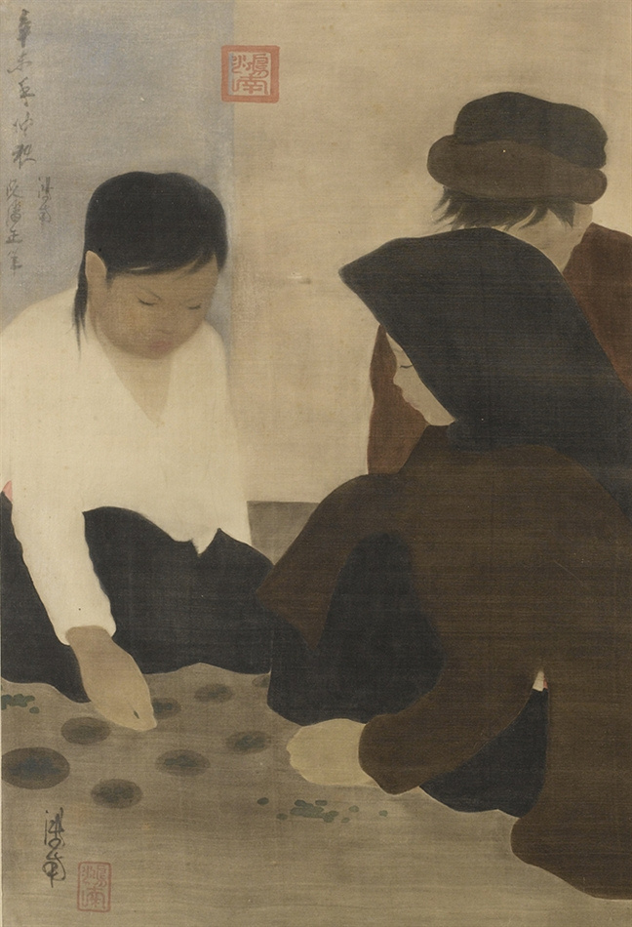

Object-Oriented Programming - IT3100E - 20222
Ô
ĂN
QUAN
Group 02
SoICT - HUST

Slide 2
Team Members
Group 02
Phan Công Anh
Nguyễn Hoàng Anh
Trần Hoàng Anh
Ngô Việt Anh
Game Model
Utils
Game Model
Music
Controller
Controller
1

Slide 3
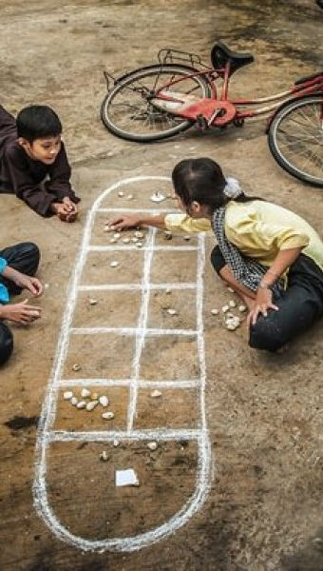
INTRODUCTI N
Ô ăn quan is a traditional boardgame which has been one of the most common traditional game for Vietnamese children. The game is simple, easy to play and very valuable for enhancing calcultating and strategical ability for children. The game has been played for thousand of years, but nowadays Vietnamese children no longer had the same passion for game like those in the past. For this circumstance, developers and researchers have been trying to take actions, to preserve and spread this game as a vital cultural heritage, and we as a team has developed a digital version of Ô ăn quan that can be easily accessed on internet, using some basic Object-oriented techniques.
2

Slide 4
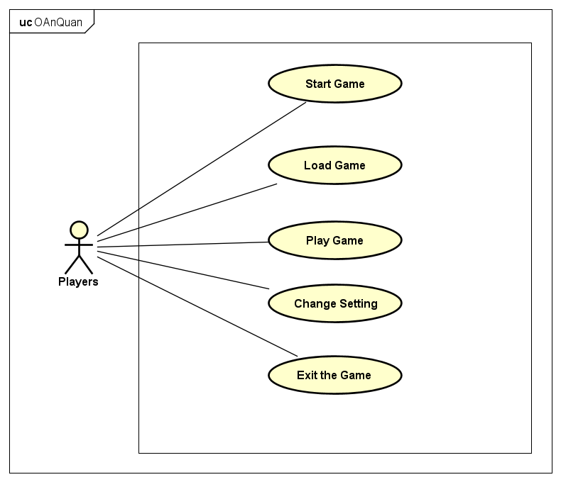
USECASE
3

Slide 5
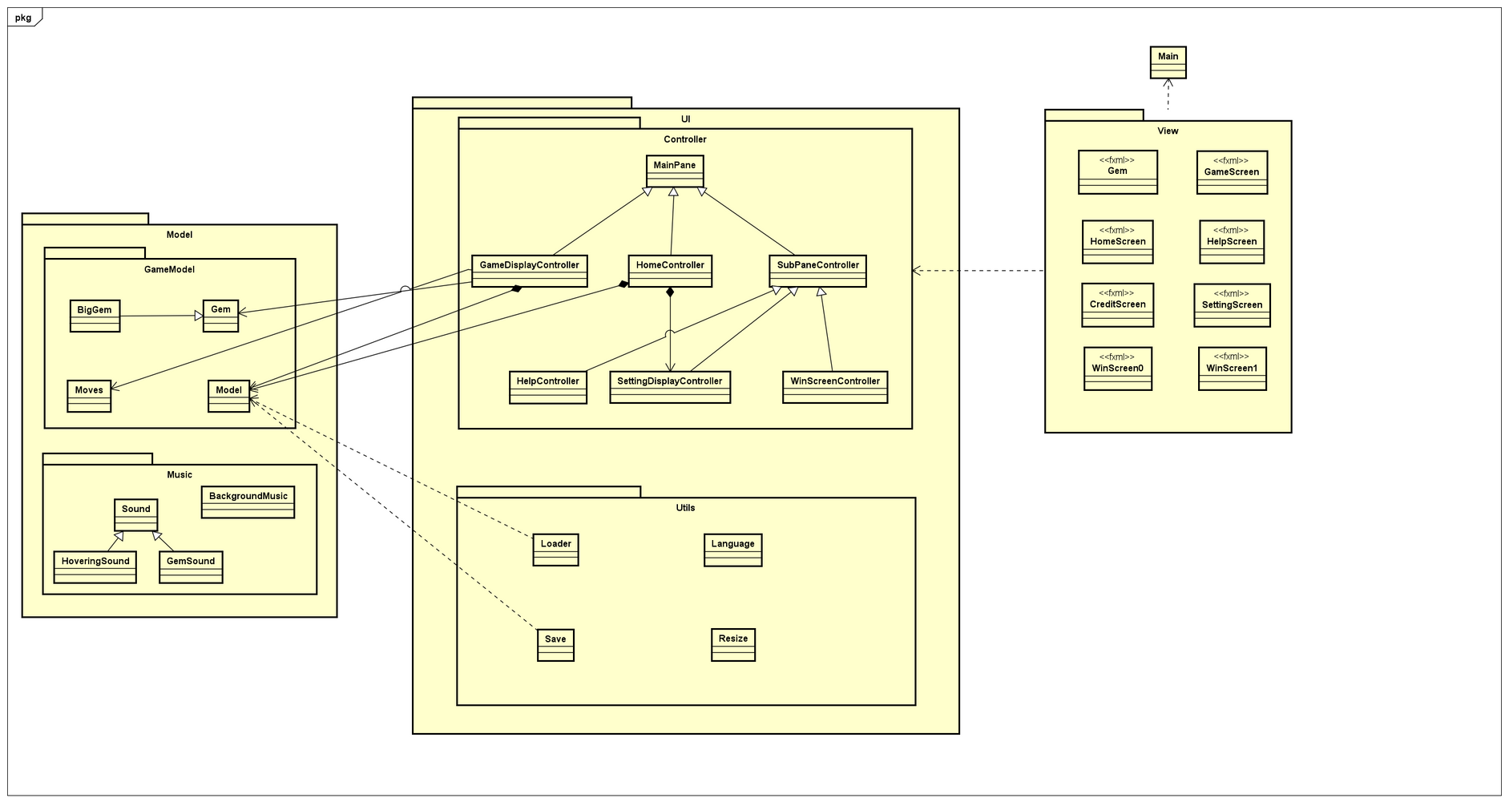
GENERAL
3

Slide 6
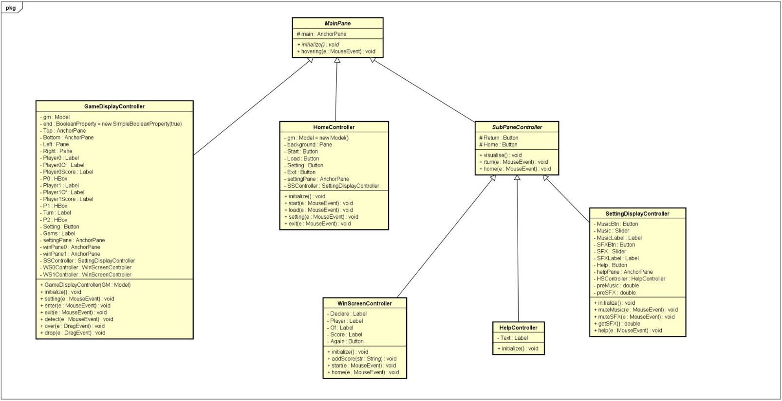
CONTROLLER
3

Slide 7
OOP TECHNIQUES
5.1. Inheritance
SettingDisplay, WinScreen, Help controller inherit the initialize and visualize method from abstract class SubPaneController , which inherit from the class MainPane .
All the Display controllers all have a Pane which is their main container. They also share the initialize and visualize method.
2

Slide 8
OOP TECHNIQUES
5.2. Association
Associations are shown between GameDisplayController class and Model, Gem as well as Move class.
2

Slide 9
OOP TECHNIQUES
5.3. Overloading
In this application, when the user chooses to save the game, the game status will be saved. It can be loaded when the user clicks the load button. With the same technique, the setting options are also saved every time they close the game and will be loaded when the application runs again. The method save is overloaded to save the game status and the setting option in one method name. The method load is also overloaded to load back the saved information when needed.
2

Slide 10
OOP TECHNIQUES
5.4. Overriding
For HoveringSound, GemSound, BackgroundMusic overrides the method “run” from the Runnable Interface”: There are many benefits of multithreading, most notably improved server responsiveness and minimized system resource usage. We implemented the Runnable interface and overriding its run method for the MusicAndSound package. The music will run separately from the main application, which will smooth the program and enhance the application throughput.
2

Slide 11
OOP TECHNIQUES
5.5. Polymorphism
When the Bind method is invoked in the Resize class, it creates an instance of either Button or Label, which is then upcasted to the parent class, Region.
2

Slide 12
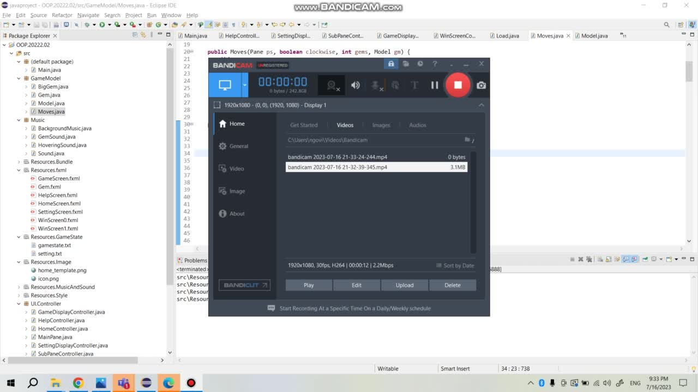
Demo link

Slide 13

Thank Y u
for listening
SoICT - HUST

